Slide 1
CPU Scheduling

Slide 2
Long-Term Scheduling
Determines which programs are admitted to the system for processing
May be first-come-first-served
Or according to criteria such as priority, I/O requirements or expected execution time
Controls the degree of multiprogramming
More processes, smaller percentage of time each process is executed
Used in batch systems

Slide 3
We will look at CPU scheduling (Short-term scheduling) only

Slide 4
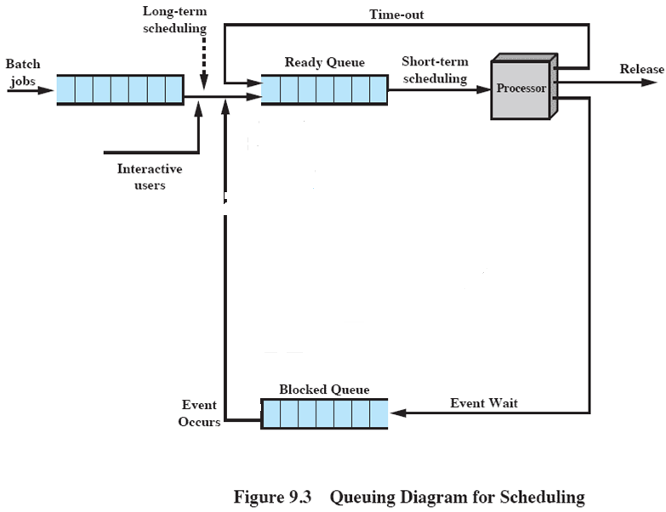
Queuing Diagram

Slide 5
CPU Scheduling
Basic Concepts
Scheduling Criteria
Scheduling Algorithms
Multiple-Processor Scheduling

Slide 6
Basic Concepts
Objective of multiprogramming is to have maximum CPU utilization
CPU–I/O Burst Cycle – Process execution consists of a cycle of CPU execution and I/O wait

Slide 7
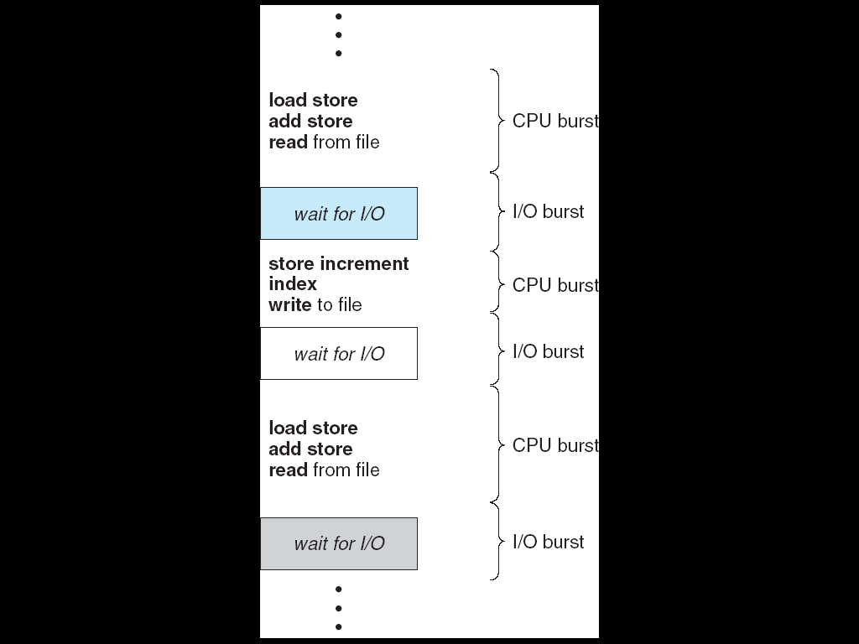
Alternating Sequence of CPU And I/O Bursts

Slide 8
Typically the CPU bursts are short
When the CPU becomes idle, scheduler (part of OS) selects a process to be executed
It selects from the ready queue
Usually the queue has a list of PCBs (process control blocks)
This may not operate as a first-in, first-out queue
We will see different scheduling algorithms

Slide 9
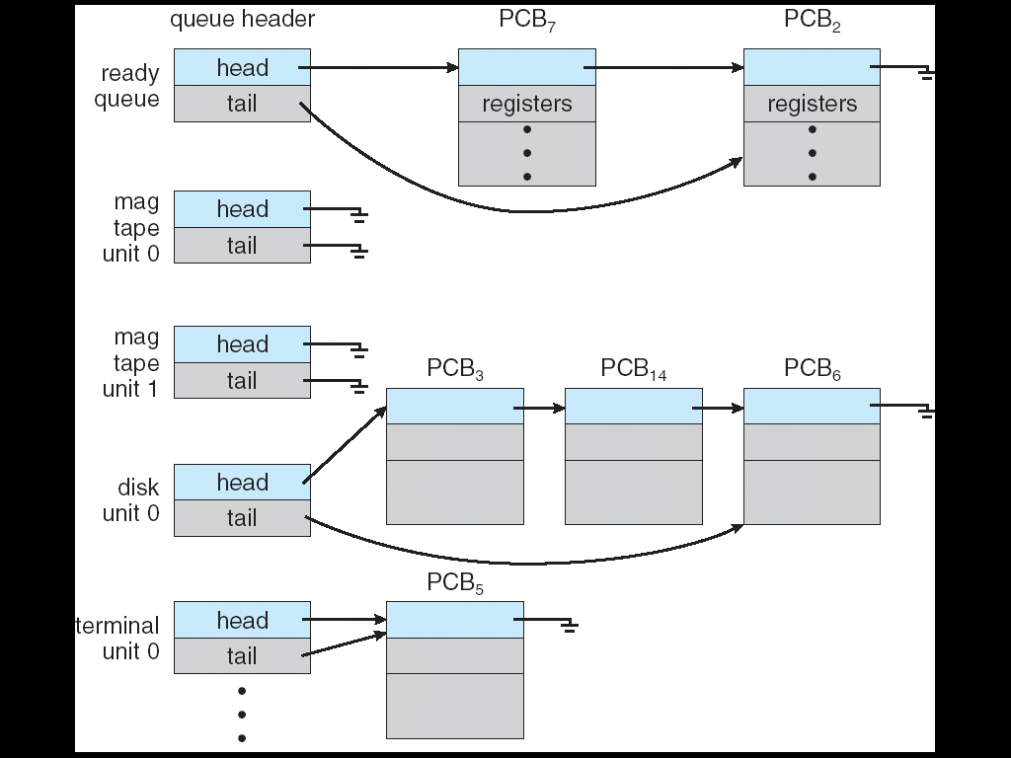
Ready Queue And Various I/O Device Queues

Slide 10
CPU Scheduler
Selects from among the processes in memory that are ready to execute, and allocates the CPU to one of them
CPU scheduling decisions may take place when a process:
1. Switches from running to blocked state
2. Switches from running to ready state
3. Switches from blocked to ready
4. Terminates
Scheduling under 1 and 4 is nonpreemptive
All other scheduling is preemptive
Notes:
e.g. as a result of I/O request
switches from running to ready only with preemptive scheduling
at completion of I/O

Slide 11
Nonpreemptive or cooperative scheduling
Once the CPU has been allocated to a process, the process keeps it until it terminates or switches to blocked state.
i.e. there is no choice – a new process must be selected
Disadvantage of nonpreemptive scheduling:
Processes may hold the CPU too long, not allowing other applications to run e.g. infinite loop program

Slide 12
Preemptive scheduling
Once a process has used up a period of time on the CPU, it is taken off and put in ready queue
Another process is then allowed to run
i.e. there is a choice here in terms of scheduling

Slide 13
Windows 95 introduced preemptive scheduling
All subsequent versions of Windows use preemptive scheduling
Linux uses preemptive scheduling

Slide 14
Dispatcher
Dispatcher module gives control of the CPU to the process selected by the short-term scheduler; this involves:
switching context
switching to user mode
jumping to the proper location in the user program to restart that program

Slide 15
Scheduling Criteria
CPU utilization – keep the CPU as busy as possible
Throughput – # of processes that complete their execution per time unit
Turnaround time – amount of time to execute a particular process
Waiting time – amount of time a process has been waiting in the ready queue
Response time – amount of time it takes from when a request was submitted until a response begins to be received
Notes:
Turnaround time includes time waiting + time executing on the CPU

Slide 16
Scheduling algorithms may have the following (sometimes conflicting goals):
Max CPU utilization
Max throughput
Min turnaround time
Min waiting time
Min response time

Slide 17
Scheduler has to decide which process in the ready queue will be allocated the CPU
Burst time is how long the process needs before it will finish or move to blocked state
We will look at various scheduling algorithms
To compare, we should look at a sequence of many CPU and I/O bursts of many processes
For simplicity, we consider only one CPU burst per process

Slide 18
First-Come, First-Served (FCFS) Scheduling
Here the ready queue is treated as a regular queue
Process Arrival Time Burst Time
P₁ 0 24
P₂ 2 3
P₃ 3 3
Note: burst times usually measured in milliseconds
Notes:
A millisecond is a thousandth of a second

Slide 19
The Gantt Chart for the schedule is:
Waiting time for P₁ = 0; P₂ = 22; P₃ = 24
Average waiting time: (0 + 22 + 24)/3 = 15.3
P₁
P₂
P₃
0
24
27
30
Notes:
Gantt chart – bar chart showing a schedule including the start and finish times of each of the participating processes
Turnaround time = waiting time + burst time
Turnaround time for P₁ = 0+24; P₂ = 22+3=25; P₃ = 24+3=27
Average turnaround (24+25+27)/3 = 76/3=25.3

Slide 20
FCFS Scheduling (Cont.)
Suppose the processes arrive in the following order
Process Arrival Time Burst Time
P₂ 0 3
P₃ 2 3
P₁ 3 24

Slide 21
FCFS Scheduling (Cont.)
The Gantt chart for the schedule is:
Waiting time for P₁ = 3; P₂ = 0; P₃ = 1
Average waiting time: (3 + 0 + 1)/3 = 1.3
Much better than previous case
Convoy effect - short process behind long process
P₂
P₃
P₁
0
3
6
30
Notes:
Convoy effect – short process behind long process => short jobs have long waiting times while the long process runs => average waiting time is long

Slide 22
Typically the average waiting time with FCFS is not minimal
A short process may have to wait a long time before it can execute
Favours CPU-bound processes – I/O processes have to wait until CPU-bound process completes
FCFS may lead to lower CPU and I/O utilisation – see note below
FCFS is nonpreemptive – a process holds the CPU until it terminates or requests I/O
Notes:
CPU bound processes/IO bound processes. How do processes behave? First, CPU/IO burst cycle. A process will run for a while (the CPU burst), perform some IO (the IO burst), then run for a while more (the next CPU burst). How long between IO operations? Depends on the process.
IO Bound processes: processes that perform lots of IO operations. Each IO operation is followed by a short CPU burst to process the IO, then more IO happens.
CPU bound processes: processes that perform lots of computation and do little IO. Tend to have a few long CPU bursts.
CPU bound process e.g. recalculating a spreadsheet or converting a large graphics file
I/O bound process e.g. A process that looks through a huge file for some data will often be I/O bound,
since the bottleneck is then the reading of the data from disk.
FCFS can also block the system in a busy dynamic system in another way, known as the convoy effect. When one CPU intensive process blocks the CPU, a number of I/O intensive processes can get backed up behind it, leaving the I/O devices idle. When the CPU hog finally relinquishes the CPU, then the I/O processes pass through the CPU quickly, leaving the CPU idle while everyone queues up for I/O, and then the cycle repeats itself when the CPU intensive process gets back to the ready queue.

Slide 23
Shortest-Job-First (SJF) Scheduling
Or Shortest-next-CPU-burst Scheduling
Associate with each process the length of its next CPU burst.
Use these lengths to schedule the process with the shortest time
If next CPU bursts of two processes are equal
FCFS is used to break the tie
Notes:
Useful in a batch system e.g. in long-term scheduling, in insurance company, to run a batch of 1000 claims, the time taken can be predicted accurately.
Has been adapted to short-term scheduling in interactive environment by using burst time instead of job time – then better to call it shortest-next-CPU-burst algorithm

Slide 24
Two schemes:
nonpreemptive – once CPU given to the process it cannot be preempted until completes its CPU burst
preemptive – will not consider this here
SJF is optimal – gives minimum average waiting time for a given set of processes
Notes:
SJF gives best waiting time because moving a short process before a long one decreases the waiting time of the short process more than it increases the waiting time of the long process. Thus average waiting time decreases

Slide 25
Example of SJF
Process Arrival Time Burst Time
P₁ 0 7
P₂ 2 4
P₃ 4 1
P₄ 5 4
SJF (non-preemptive)
Average waiting time = (0 + 6 + 3 + 7)/4 = 4
P₁
P₃
P₂
P₄
0
3
7
8
12
16

Slide 26
Determining Length of Next CPU Burst
Can only estimate the length
Can be done by using the length of previous CPU bursts for that process

Slide 27
Round Robin (RR)
Each process gets a small unit of CPU time (time quantum), usually 10-100 milliseconds.
After this time has elapsed, the process is preempted and added to the end of the ready queue.
Thus RR scheduling is preemptive

Slide 28
If there are n processes in the ready queue and the time quantum is q, then each process gets 1/n of the CPU time in chunks of at most q time units at once.
No process waits more than (n-1)q time units.
e.g. 5 processes, time quantum of 20ms
Each process will get at least 20ms in every 100ms
Performance
q large ⇒ same as FCFS
q small ⇒ q must be large with respect to context switch, otherwise overhead is too high
Notes:
When CPU switches to another process, the system must save the state of the old process and load the saved state for the new process via a context switch
OS uses PCB for this
One problem with preemptive scheduling in general is that the context-switching overhead may tend to
dominate if the system is not carefully tuned.

Slide 29
Time required for context switch is typically less than 10 ms
Most OS use time quanta between 10 and 100 ms
Rule of thumb – for optimal results 80% of CPU bursts should be shorter than time quantum

Slide 30
Example of RR with Time Quantum = 20
Process Arrival Time Burst Time
P₁ 0 53
P₂ 3 17
P₃ 4 68
P₄ 6 24
The Gantt chart is:
Typically, higher average turnaround time than SJF, but better response
P₁
P₂
P₃
P₄
P₁
P₃
P₄
P₁
P₃
P₃
0
20
37
57
77
97
117
121
134
154
162

Slide 31
Example of RR with Time Quantum = 20
Process Arrival Time Burst Time
P1 0 53
P2 3 25
P3 44 58
P4 50 24
The Gantt chart is:
Typically, higher average turnaround time than SJF, but better response
P₁
P₂
P₁
P₂
P₃
P₄
P₁
P₃
P₄
P₃
0
20
40
60
65
85
105
118
138
142
160

Slide 32
Multiple-Processor Scheduling
CPU scheduling more complex when multiple CPUs are available
One approach here is symmetric multiprocessing – SMP
Each processor is self-scheduling
Processes may be in a common ready queue
Or
each processor may have its own queue

Slide 33
Scheduling in Windows 7 and Linux
Windows 7 uses a combination of priority-based and round robin scheduling algorithm
Linux is similar

Slide 34
Characteristics of Windows 7’s priority strategy
Gives very good response times to interactive threads that are using the mouse and windows
Enables I/O-bound threads to keep the I/O devices busy
Compute-bound threads soak up the spare CPU cycles in the background

Slide 35
Windows distinguishes between the foreground process that is currently selected on the screen, and the background processes that are not currently selected.
When a process moves to foreground, Windows increases boosts it’s thread’s priorities and increments the scheduling quantum.

Slide 36
The kernel dynamically adjusts the priority of a thread depending on whether it is I/O-bound or CPU-bound
I/O-bound threads have their priority boosted as long as they do not run to the end of their scheduling quantum.

